Slide 2
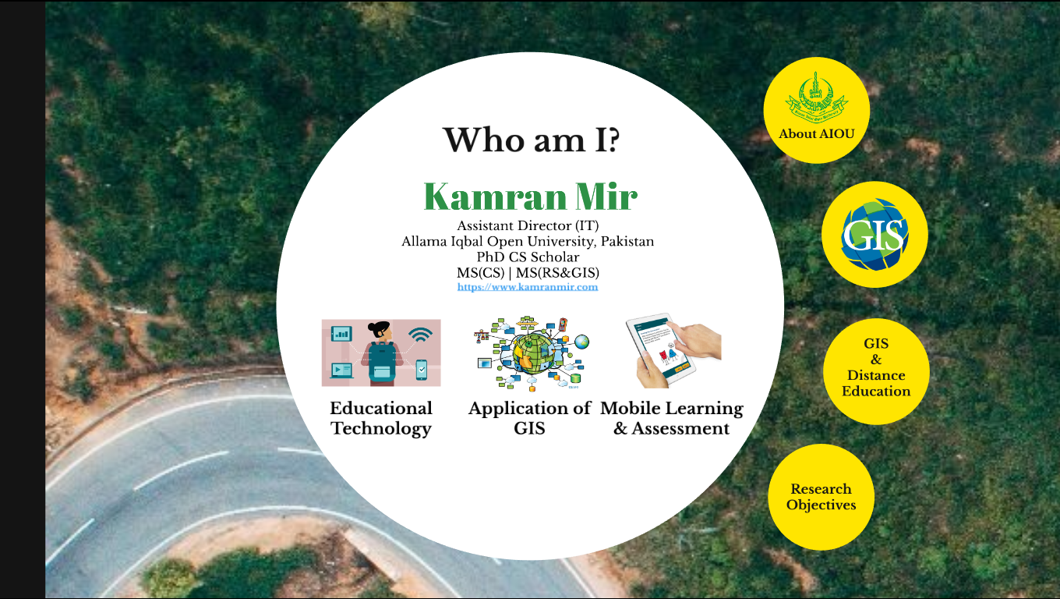
Introduction

Slide 3
About AIOU

Slide 4
What is GIS?

Slide 5
GIS & Distance Education

Slide 6
GIS & Distance Education

Slide 7
GIS in Distance Education
Administration
Resource Allocation
Teaching / Learning
Interactive Maps
Decision Making
Top Management

Slide 8
Related Studies

Slide 9
Research Objectives

Slide 10
Research Methodology

Slide 11
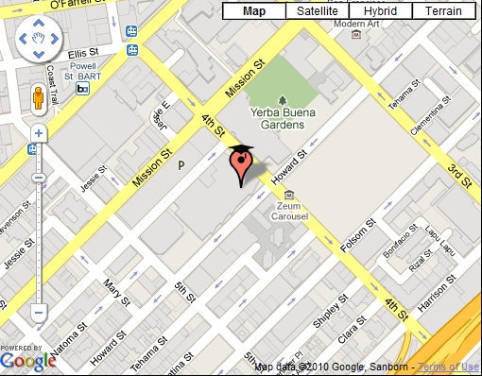
Address Geocoding
H No. 495, Street 10, I-10/4, Islamabad

Slide 12
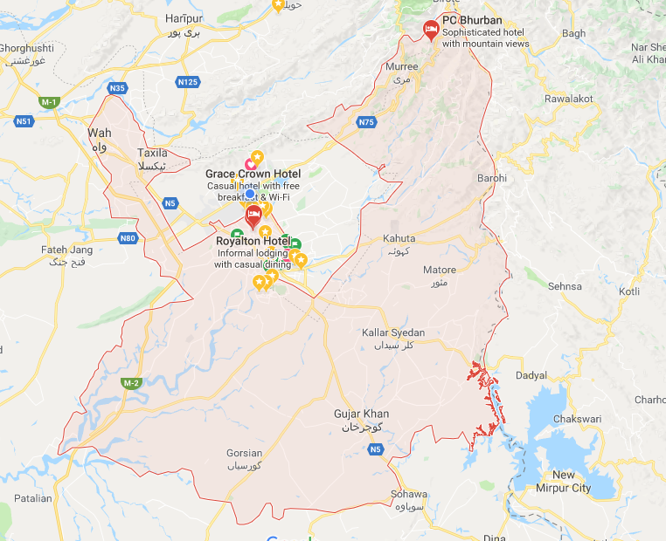

Slide 13
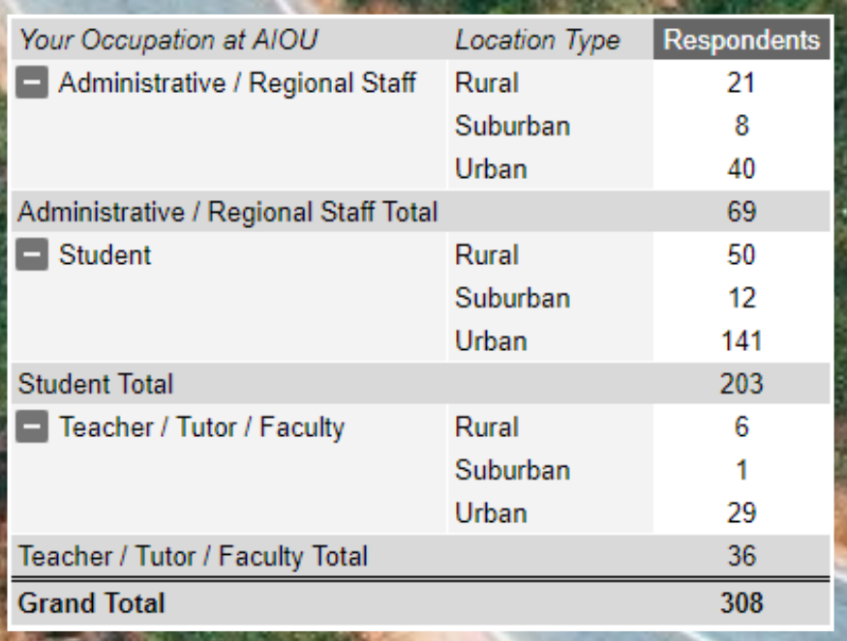

Slide 14
Survey Results

Slide 15
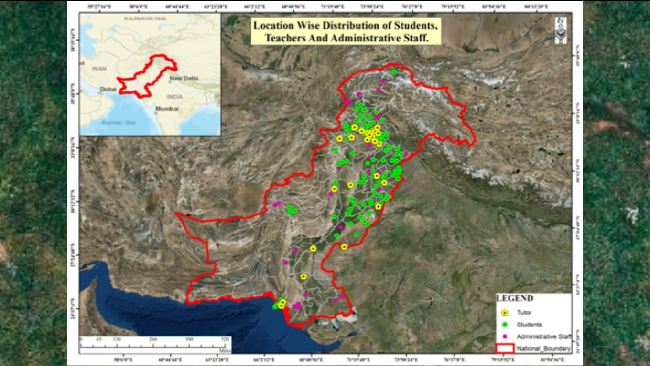
Survey Responses

Slide 16
Student Responses

Slide 17
Student Responses

Slide 18
Student Responses

Slide 19
Faculty Responses

Slide 20
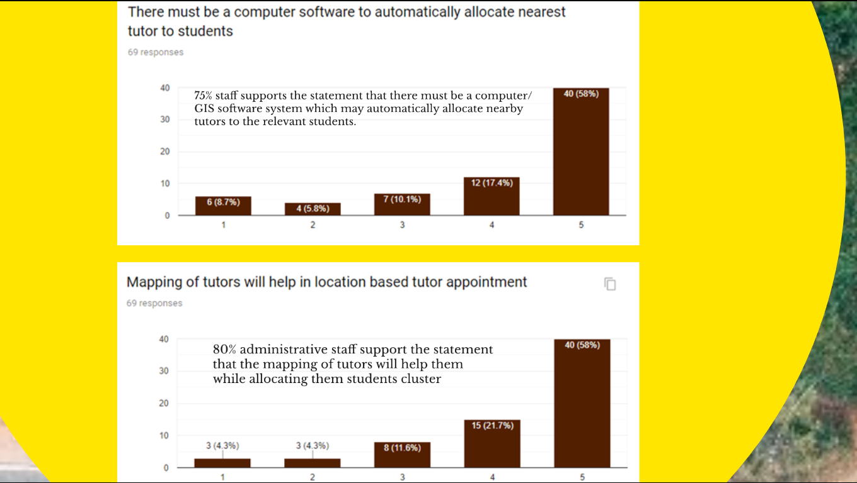
Staff Responses

Slide 21
Conceptual Model

Slide 22
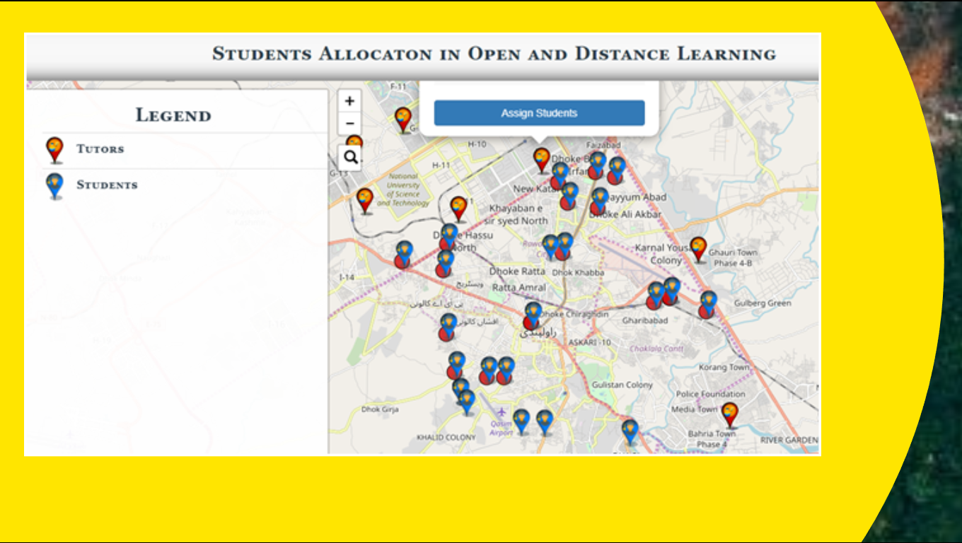
Prototype GIS Application

Slide 23
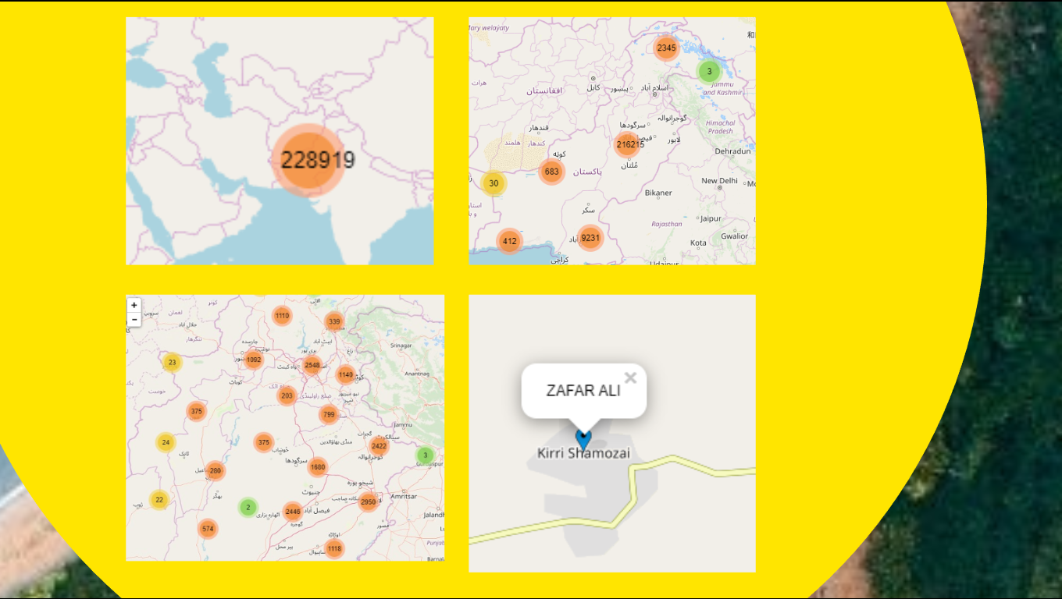
Example Maps

Slide 24
Conclusion & Recommendations

