Slide 1


A Comparative Study of Knowledge and Use of Blooms’ Digital Taxonomy by Teachers and Students in Virtual and Conventional University
Presented In
The 33rd Annual Conference of the Asian Association of Open Universities
Hina Amin
Instructor Education & PhD Scholar
Dr. Munawar Sultana Mirza
Head of Department, Education
VIRTUAL UNIVERSIYTY OF PAKSITAN

Slide 2
Background Introduction
Students are expected to display higher order thinking skills throughout their educational development (Collins, 2014).
Teachers use Blooms’ taxonomies as a compulsory and vital hierarchical instructional set to develop higher and lower order thinking skills in students (Munzenmaier and Rubin, 2013).
However, if the teachers use these digital tools correctly and embed it in instruction, the gap between education and technology can be reduced (Wedlock & Gorwe, 2017).

Slide 3
Three Versions of Blooms’ Taxonomy
1. Original Bloom’s Taxonomy (Bloom et al. 1956)
2. Bloom’s Taxonomy Revised (Anderson & Krathwohl, 2001)
3. Bloom’s Digital Taxonomy (Churches, 2008)

Slide 4
Notes:
Comparison of Blooms’ Taxonomy (Gonzalez-Major & Albright, 2008)

Slide 5
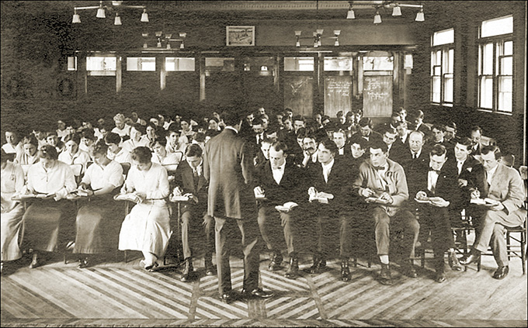
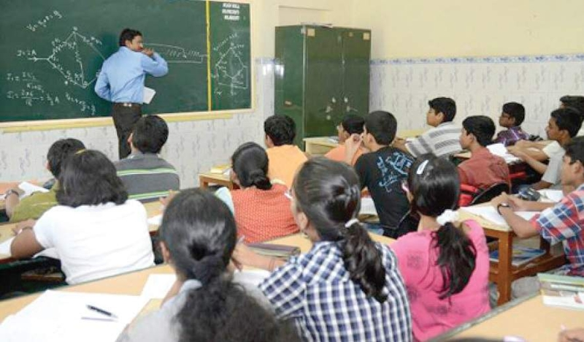

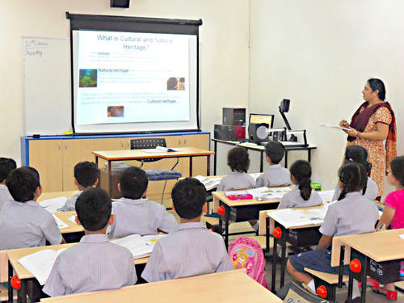
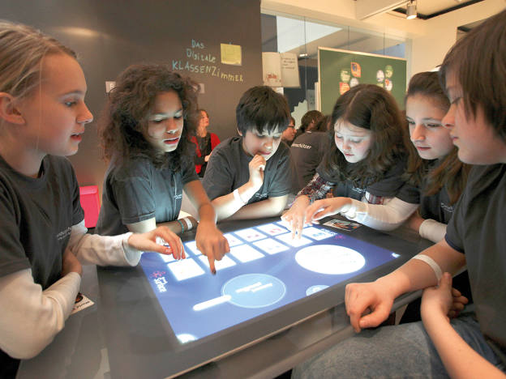

Why Blooms’ Digital Taxonomy?

Slide 6
Objectives of the Study
1. Find out the knowledge of teachers and students regarding Blooms’ Digital Taxonomy in virtual and conventional universities;
2. Identify and compare the frequency of using different levels of Blooms’ Digital Taxonomy by teachers and students in virtual and conventional universities;
3. Explore the levels of Blooms’ Digital Taxonomy for higher and lower order thinking skills among teachers and students in virtual and conventional university.

Slide 7
Hypotheses of the Study
1. H0₁= There is no difference between the students’ knowledge and use of Blooms’ digital taxonomy in virtual and conventional university.
2. H0₂= There is no difference between the teachers’ knowledge and use regarding Blooms’ digital taxonomy in virtual and conventional university.

Slide 8
3. H0₃= There is no difference between the lower and higher order thinking of students with respect to Blooms’ Digital Taxonomy in virtual and conventional university.
4. H0₄= There is no difference between the lower and higher order thinking of teachers with respect to Blooms’ Digital Taxonomy in virtual and conventional university.

Slide 9
Theoretical Framework of the study
Blooms’ Digital Taxonomy proposed by Churches (2009) was used as theoretical framework for this study.
The list of all the digital tools used in this research with respect to this categorization is as follows:

Slide 10
Level of Blooms’ Digital Taxonomy | List of Blooms’ Digital Tools
 |  | Lower Order thinking | Higher order thinking
Remembering | Bookmarking/social book marking/ Favouriting, Googling
Understanding | Advance searching, Blog Journaling Subscribing, Tagging
Applying | Content Authoring & Wiki Editing Collaborating though e-tools Skyping, Interactive Whiteboard
Analyzing |  |  | Data processing through computers
Evaluating |  |  | Validating information & Referencing
Creating |  |  | Podcasting, Recording videos & Digital Publishing

Slide 11
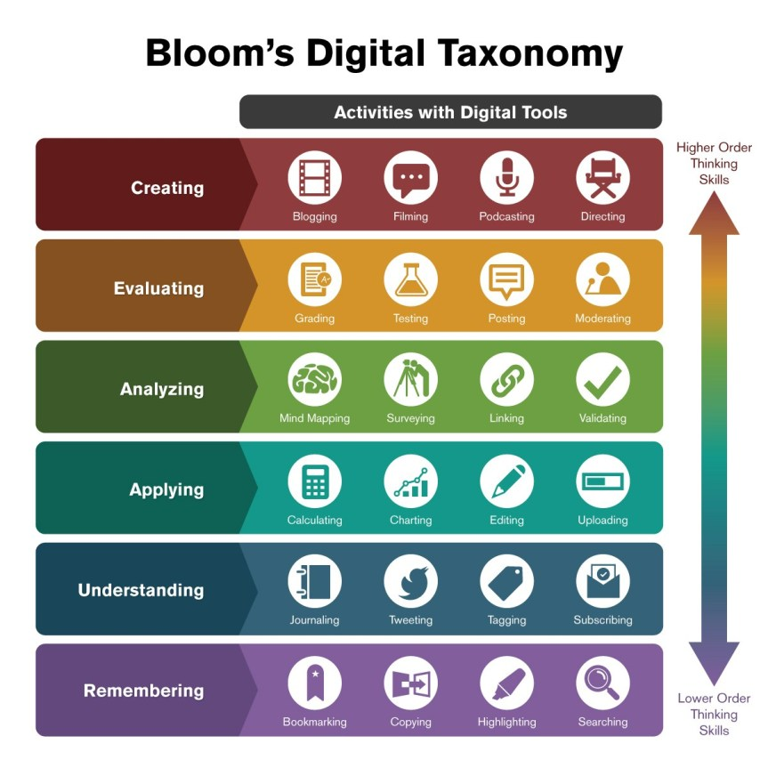
Notes:
Bloom’s Digital Taxonomy with tools (Info graphic Credit: Ron Carranza, as cited in Sneed, 2016)

Slide 12


Research Methodology
Nature: Descriptive research
Method: Survey research
Population
All the students enrolled during Spring 2019 and full time teachers of faculty of education of one online and one conventional university.

Slide 13
Sampling Technique and Size
Students in Faculty Edu.
1139 in online university and 1809 in conventional university.
Sample of 558 (20%) students selected using Proportionate sampling .
Teachers
All the teachers of faculty of education from an on-line and one conventional university were selected through census sampling

Slide 14
Instrument Reliability
Researchers developed the survey by using digital tools mentioned for each level in Bloom’ Digital Taxonomy proposed by Churches (2009).
Digital tools associated with each level were identified and divided according to the hierarchical levels of Bloom digital taxonomy i.e. remembering to creativity.
Blooms’ Digital Taxonomy questionnaire (BDTQ) was pilot tested from a sample of 40 students.
The value for blooms’ digital taxonomy is .924 which makes the instrument highly reliable.

Slide 15
Table 1
Response rate of sample
Universities | Students’ sample size | Response rate | Teachers ‘sample size (Census) | Response rate
University of the Punjab | 361 | 243 (67%) | 49 | 32 (65%)
Virtual University of Pakistan | 227 | 184 (82%) | 19 | 18 (100%)
Total | 588 | 427 | 68 | 50

Slide 16
Data Analysis
Students’ Data
A Shapiro-Wilk test applied to see the normality of students’ data. With P –value α= .110 parametric statistic were applied for analysis of students’ data.
Teachers’ Data
A Shapiro-Wilk test applied to see the normality of students’ data. With P –value α= .04 non-parametric statistic were applied for analysis of teachers’ data.
Notes:
skewness of -.174 (SE = .118) and a kurtosis of -.073 (SE = .236) for Students
skewness of .632 (SE = .337) and a kurtosis of -.148 (SE = .662) for Teachers

Slide 17
Table 2
Range, Mean & SD of different levels of Bloom’s Digital Taxonomy for students and teachers
Levels of Bloom’s Digital Taxonomy Sections | Students (N= 427) |  |  |  | Teachers (N= 50)
Sections (I-X) | AR* | Range | Mean | SD | Range | Mean | SD
Remembering (Bookmarking) | 4-20 | 16 | 12.07 | 3.19 | 14 | 12.70 | 3.13
Understanding (Advance searching) | 4-20 | 16 | 15.34 | 3.48 | 12 | 14.08 | 2.92
Understanding (Blog Journaling) | 5-25 | 20 | 12.03 | 5.27 | 20 | 13.84 | 4.14
Applying (Content Authoring) | 5-25 | 20 | 12.56 | 4.46 | 17 | 15.70 | 4.39
Applying (Collaborating using e-tools) | 5-25 | 20 | 23.77 | 6.92 | 15 | 17.14 | 3.21
Applying (Skyping) | 8-40 | 32 | 16.45 | 4.31 | 40 | 25.78 | 6.60
Applying (IWB) | 8-40 | 32 | 22.65 | 7.02 | 32 | 23.68 | 7.12
Analyzing (Data Processing) | 7-35 | 28 | 22.0 | 7.11 | 25 | 21.80 | 5.38
Evaluation (Validating information) | 6-30 | 24 | 19.56 | 5.17 | 17 | 19.64 | 3.58
Creativity(Podcasting & Digital publication) | 7-35 | 28 | 18.83 | 7. 31 | 23 | 20.94 | 5.47
Notes:
*Actual Range/Theoretical range of instrument
Above table presents the mean of different levels of Bloom’s digital taxonomy. Highest Mean (M=23.77, SD=6.92) is attributed to applying level (Collaborating through e-tools) and Skyping (M=16.45, SD=4.31) for students. For other levels of Blooms’ digital taxonomy, the average means were observed. It is said that students’ knowledge and use of digital bloom’s taxonomy for applying level is less as compared to other levels.
Responses of teachers showed highest Mean (M=14.08, SD=2.92) for understanding level (advance searching) and for rest of the levels average means were observed. It is concluded that students of virtual university of Pakistan has more knowledge and use of digital tools as compared to teachers.

Slide 18
Table 3
Difference between knowledge and use of Blooms’ Digital Taxonomy with modes of learning
Students N=427 Independent-sample t-test |  |  |  | Teachers N=50 Mann-Whitney U test
Variable | Mean | SD | Sig. | Median | Mann-Whitney U | Sig.
Virtual University of Pakistan | 177 | 28.6 | .03 | 188.5 | 172.5 | .02
University of the Punjab | 170 | 33.1 |  | 176.0
*p< .05
Notes:
Difference of knowledge and use of bloom digital taxonomy exists between virtual and conventional university students. On the other hand, Mann-Whitney U test revealed the difference in knowledge and use of Bloom’s digital taxonomy between virtual university teachers (Md = 188.5, n =18) and Punjab university teachers (Md =176.0, n =32), U = 172.500, z = -2.335, p= .02.
The magnitude of difference was also tested by using eta square, universities showed (.01 & .03) in the mean scores of students and teachers, respectively.
The magnitude of difference was also tested by using eta square, universities showed (.01 & .03) in the mean scores of students and teachers, respectively

Slide 19
Table 4
Difference between the use of levels of blooms’ digital taxonomy by students of two modes of learning (N=427)
Levels & Sections | University | N | Mean | SD | Sig.
Blog Journaling & Advance searching (Understanding) | VUP | 184 | 15.89 | 3.19 | .00
 | PU | 243 | 14.93 | 3.63
Skyping (Applying) | VUP | 184 | 17.46 | 4.47 | .00
 | PU | 243 | 15.76 | 4.03
Validating information & Referencing (Evaluating) | VUP | 184 | 20.12 | 5.61 | .05
 | PU | 243 | 19.13 | 4.78
*p< .05
Notes:
Independent sample t-test was applied to determine the significance of difference in the use of different levels of blooms’ digital taxonomy by the students of the two types of universities. Table shows that “p-value” .004, .000 & .05 for understanding, applying and evaluating levels was significant. Thus, it is concluded that students’ knowledge and use of digital taxonomy is significantly different at the two universities at the three levels.

Slide 20
Table 5
Difference between the use of levels of blooms’ digital taxonomy by teachers of two mode of learning (N=50)
Levels & Sections | University | N | Median | Mann-Whitney U | Sig.
Bookmarking & Favouriting (Remembering) | VUP | 18 | 14.50 | 134.0 | .02
 | PU | 32 | 12.0
Blog Journaling & Advance searching (Understanding) | VUP | 18 | 15.50 | 189.0 | .04
 | PU | 32 | 13.0
Skyping (Applying) | VUP | 18 | 28.0 | 155.5 | .00
 | PU | 32 | 23.5
Data processing through computers (Analyzing) | VUP | 18 | 23.5 | 166.0 | .01
 | PU | 32 | 20.0
Notes:
Mann-Whitney U test was applied to determine the significance of difference in the use of different levels of Blooms’ digital taxonomy by the teachers of the two types of university. Table shows that “p-value” .02, .04 & .01 for remembering, understanding, applying and analyzing levels was significant. Thus, it is concluded that teachers’ knowledge and use of Blooms’ digital taxonomy is significantly different at the two universities at the four levels.

Slide 21
Table 6
Difference between the lower and higher order thinking with the two modes of learning by students and teachers
Variable | University | Students N=427 Independent-sample t-test |  |  |  |  | Teachers N=50 Mann-Whitney U test
 |  | Mean | SD | df | Sig. |  | Median | Mann-Whitney U | Sig.
Lower order Thinking | VUP | 115.52 | 19.18 | 425 | .12 |  | 128.0 | 177.0 | .02
 | PU | 112.28 | 22.94 |  |  |  | 119.0
Higher order Thinking | VUP | 61.1 | 13.3 | 395.24 | .01 |  | 62.50 | 225.0 | .20
 | PU | 57.82 | 13.4 |  |  |  | 60.50
*p< .05
Notes:
Test was applied to determine the significance of difference on lower and higher order thinking of students. Table shows that VUP students have higher mean (M=61.1) as compared to the conventional university (M=57.82) with p-value .01 for higher order thinking. Thus, the difference on higher order thinking skills of blooms’ digital taxonomy exists between virtual and conventional university students. On the other hand, table shows that for the lower order thinking skills teachers of Virtual university have higher Median= 128.00 as compared to the conventional university’s Median=119.000. Thus, the difference on lower order thinking skills of blooms’ digital taxonomy between the virtual and conventional university teachers’ is significant.

Slide 22
Table7
Difference between use of Bloom’s Digital taxonomy based on age of students of two modes of learning (N=427)
Source of variation | Sum of Squares | Df | Sig.
Between Groups | 8616.270 | 3 | .03
Within Groups | 410349.983 | 423
Total | 418966.253 | 426
Table 8
LSD POST HOC test of multiple comparison on the basis of age
Comparison | Mean | Mean Difference | Significance
20-25 Years VS 31-35 Years | 174.8 vs. 162.9 | 11.9* | .03
31-35 Years VS 36-40 Years | 162.9 vs. 176.80 | -13.9* | .04
Notes:
The above table shows that by age difference in the use of digital blooms taxonomy is significant as (F = 2.961, p = .03). Based on significant p-value, “LSD Post Hoc Test of Multiple Comparisons was applied.
Post Hoc test showed that students with age group of 20-25 years, 31-35 years, and 36-40 years display significant notable difference on knowledge and use of blooms’ digital taxonomy as compared to other age groups. Interesting to note that the students of older age had the highest mean score followed by the youngest group with middle age group having the lowest mean score.

Slide 23
Implications
The study presented and briefly discussed the knowledge and use of Blooms’ Digital Taxonomy for lower and higher thinking skills.
Teachers & Students in ODL
Use of digital Instructional tools for Personalized learning
https://www.educatorstechnology.
com/2013/08/web-tools-to-use-with-blooms-digital.html
3.Training of Teachers on the philosophy of Bloom’s Digital Taxonomy
4. The EDUCATION 4.0 in Action: Future Ready Education
(Example the chatbot Backy)
Notes:
The chatbot, known as Becky, which is developed at Leeds Beckett University in two months for just £30, won the Jisc-sponsored digital innovation of the year award.

Slide 24
Any Question?

