Slide 1
AN EVALUATION OF UNIVERSITAS TERBUKA’S SERVICES BASED ON EMPLOYEES PERCEPTION
herman@ecampus.ut.ac.id

Slide 2
Introduction
Service Quality (SQ) and Customers’ Satisfaction (CS) are important constructs (Felix, 2017).
These constructs have a cause and an effect in influencing the customers
Universitas Terbuka (UT) needs to measure SQ and CS

Slide 3
Research Questions
How to develop an instrument to measure employees' satisfaction, which is valid and reliable?
How strong is the correlation between the constructs of importance and satisfaction?
What are the services that need to be improved?

Slide 4
Theories
Services is a descriptive detail of consumers’ need on how to make them satisfied, what the institution must do to the consumers, and how to reach the goal of satisfying the consumer (Edvardsson, & Olsson, 1996)
Satisfaction is the difference between consumer expectation before buying the service and after experiencing the service

Slide 5
Method
Population was UT employees (around 1.000) consisted of administrative and lecturers
Sample was 402 employees
The measurement was on the constructs of Importance and Satisfaction
The instruments was developed based on SERVQUAL which were reliability (6), responsiveness (3), assurance (4), empathy (3), and tangible (13)

Slide 6
Method
The number of items was 29
The scale was 6
The analysis were Descriptive, Quadrant, Exploratory FA, Correlation, Chi-Square

Slide 7
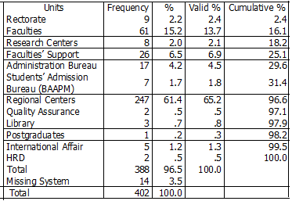
The Result, (Respondents)

Slide 8
Respondents

Slide 9
All items in instrument was valid
Instrument was reliable
All the KMO and Bartlett’s Test fulfilled the requirements in using Factor Analysis.
Relationship between constructs

Slide 10
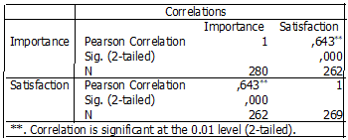
The Correlation

Slide 11
Quadrant
Even though seven services had to be considered as problems, however, in general, the employees satisfied with UT's services. The problems in UT’s service were as follows:

Slide 12
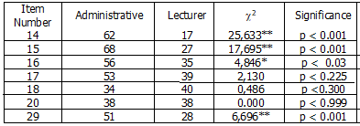
The difference between Adm. and lecturer

Slide 13
14. A chance to get further study
15. A chance to have scholarship
16. A chance to get technical training
17. A chance to have managerial training
18. Taking care of managing official rank
20. A Chance to ask for the result of
performance evaluation
29. Attention from superiors on one’s problems

Slide 14
Conclusion
Basically since 2014 UT has already had a policy that every administrative staff can take masters’ degree. However, the policy was not well realized by the staff
In general, all UT staff were satisfied with UT’s policy.

Slide 15
Thank you Very much

