Slide 1
STUDENT SATISFACTION IN ODL :
A DETERMINANT OF QUALITY SERVICE IN ACADEMIC ADMINISTRATION
Heriyanni M
Andi Sylvana
Subirman Musa
UNIVERSITAS TERBUKA
INDONESIA

Slide 2
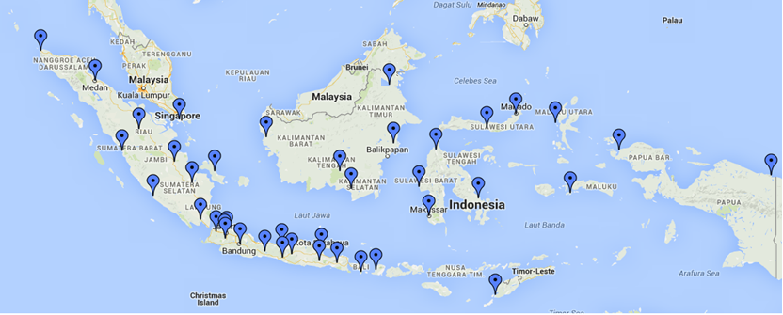
INTRODUCTION
UNIVERSITAS TERBUKA (UT) is the 45 ^{th} state university in Indonesia. It is the first university in Indonesia who applies a distance and open learning system. With 292.456 students, UT has 39 regional offices which scattered in all provinces in Indonesia, and one regional offices who handles Indonesia students in other countries.

Slide 3
INTRODUCTION
Service Quality
Student Satisfaction
How Social Media Influences Purchase Decisions
The success of Universitas Terbuka (Open University) is heavily defined by service quality offered particularly in academic services through the context of user satisfaction, which in this regard refers to student satisfaction.

Slide 4
Service Quality’ Variable Used
Tangibles represent an organization’s ability to show its existence to external parties.
Reliability is related to organizational ability to provide service as it is promised in a reliable and accurate manner
Responsiveness is the ability of employees to assist customers and provide responsive service and clear information delivery.
Assurance is knowledge, courtesy and ability of employees to instill consumers trust. The concept
Empathy is about giving genuine, individual and personal attention to consumers in order to understand what they essentially want.

Slide 5
Academic Administration Service
ONLINE AND MOBILE REGISTRATION
DIGITAL STUDENT ID CARD
ELECTRONIC PAYMENT
SUPPORTING SERVICES: SMS BLAST , HALLO UT, STUDENT’S COMPLAIN ETC
DIGITAL BOOK

Slide 6
Academic Process
Student’s Orientation
Academic Councelling
Tutorials
Graduation
Examination

Slide 7
METHOD
Online questionnaires are diistributed to 157 students of Makasar regional offices who was in semester 7 or 8, but 100 students who responded completely and processed in multiple linear regression.

Slide 8
RESULTS
STUDENT SATISFACTION
1
RELIABILITY
2
RESPONSIVENESS
1
3
ASSURANCE
4
EMPATHY
5
TANGIBLES

Slide 9
The Result of The Study
Variables |  | Mean
Tangibles | X1 | 3.8
Reliability | X2 | 4.1
Responsiveness | X3 | 3.7
Assurance | X4 | 4.0
Emphaty | X5 | 3.7
Students Satisfaction | Y | 4.39

Slide 10
Independent Variable | Dependent Variable | t | Sig t
Tangibles (X1) | Student Satisfaction (Y) | 9.606 | .000
Reliability (X2) |  | 14.577 | .000
Responsiveness (X3) |  | 12.022 | .000
Assurance (X4) |  | 3.811 | .000
Empathy (X5) |  | 5.683 | .000
R² = .959
Adjusted R²= .957
F = 441.190
Sig F |  |  | .000

Slide 11
Conclusion
Service quality—with respect to tangibility, reliability, responsiveness, assurance and empathy—has a positive and significant effect on student satisfaction. To enhance student satisfaction, it is therefore necessary to closely evaluate these aspects to get a good sense of what a service looks like and make strategic plans for improvement where necessary.

Slide 12
THANK YOU

