Slide 1
Research on the Application of Data Visualization and Analysis Technology in Online Education
The Open University of China Wei Fangfang

Slide 2
introduction
4 million students
School introduction
45 branches
11 billion requests
Notes:
The open university of china is being transformed from a traditional distance education institution to an online educational institution. It is a system, a headquarters and 45 branches, each branch has its own requirements and individual requirements. It currently has 4040 thousand students and a student oriented online learning platform that produces nearly 11 billion requests per semester.

Slide 3
1
Research Background
2
Visualization Technology
Main parts
3
Application
4
Conclusion

Slide 4
section
1
Research Background

Slide 5
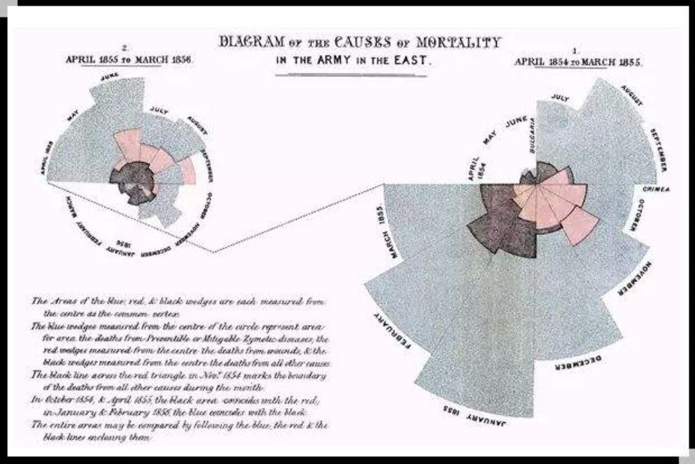
1 Research Background
Florence Nightingale
nightingale rose diagram
Notes:
China Internet Network Information Center (CNNIC) released the fortieth statistical report on China's Internet development in Beijing. The report shows that as of December 2018, the number of online education users in China has reached 201 million, compared with the end of 2017, it increased 17.5 percent. Faced with such a large scale of online education, the quality of teaching has attracted much attention.

Slide 6
1 Research Background
application | 2017.12 |  | 2018.12
Instant messaging | User scale (thousand) | Utilization rate of Internet users | User scale (thousand) | Utilization rate of Internet users | Annual growth rate
Search Engines | 639560 | 82.8% | 681320 | 82.2% | 6.5%
Internet financial management | 128810 | 16.7% | 151380 | 18.3% | 17.5%
Online education | 155180 | 20.1% | 201230 | 18.3% | 17.5%
CNNIC
Notes:
China Internet Network Information Center (CNNIC) released the fortieth statistical report on China's Internet development in Beijing. The report shows that as of December 2018, the number of online education users in China has reached 201 million, compared with the end of 2017, it increased 17.5 percent. Faced with such a large scale of online education, the quality of teaching has attracted much attention.

Slide 7
1 Research Background
Visualization technology has not been a good practice case.
The sample size of faculty and staff in Colleges and universities is small.
Problem
The use of popular visualization tools by educational teams is not enough.
Notes:
The open university of china is being transformed from a traditional distance education institution to an online educational institution. It is a system, a headquarters and 45 branches, each branch has its own requirements and individual requirements. It currently has 4040 thousand students and a student oriented online learning platform that produces nearly 11 billion requests per semester.

Slide 8
section
2
Visualization Technology

Slide 9
2 Visualization Technology
Raw data
Normative data
Visual chart
Notes:
the key technical methods of our system involved in the 4 layers of "data source layer - data aggregation layer - data processing and learning analysis layer - application service layer" . The off-line data of enrolment, Data source layer include educational administration, learning platform, learning space and scientific research data. The main task of heterogeneous data extraction and integration in Data aggregation layer, Data processing and learning analysis mainly use statistical analysis, clustering, prediction, relationship mining, text mining, social network analysis and other data mining methods to perform basic processing and in-depth analysis of data. The application service layer is based on Web pages, Birt reports, Echarts charts, etc and draws a visualization method such as a histogram, a pie chart, a radar chart, a line chart, a cloud chart to present each indicator for achieve school and student situation analysis.

Slide 10
2.1 Data diversification
Data visualization needs to be combined with time and geographical information, considering the characteristics of data structure, data hierarchy and data dimension.
Teachers' teaching activities include enrollment, opening classes, teaching, testing, training, scientific research and so on.
Students' learning activities in the complete learning cycle include enrollment, course selection, classes, examinations, graduation, etc.

Slide 11
2.2Visualization tools
Integrates charts, functions and formulas to process raw data.
. xls and. xlsx type files as input files.
Power BI
the "Magic Quadrant" of leaders.
connect Excel, web, database, CSV and other data sources.
the color is monotonous.
Excel
Tools
run on PC , mobile terminals
relies on the Zrender.
User requirements are relatively high.
the "Magic Quadrant" of leaders.
providing rich charts, without programming and development foundation
Echarts
Tableau
Notes:
The cloud service data aggregation pattern is shown in the Figure , The arrow solid line represents offline extraction and the dotted line represents real-time extraction. The off-line data are stored in object storage service (OBS) through data migration service CDM of Huawei Cloud. Data warehouse (DWS) loads students' learning history data from OBS.
Real-time incremental data is written into the data access service( DIS )or DIS Agent according to the time stamp. It is transmitted to the real-time stream computing service CS. The standard data in CS is stored in the data warehouse DWS together with the offline data. The log data of flow calculation is counted according to behavior classification, and the statistical results are written into RDS for large-screen display.

Slide 12
section
3
Application

Slide 13
国开国开学习分析云平台
3 Online learning analysis
Learning outcomes
Online learner
Online learning process
Analyzes the learning subjects including teachers, students, managers and researchers.
Analyzes basic data of users, behavior data, interaction data and other data generated.
Analyzes the current situation, the amount of learning, the quality and learning effects.
Online learning analysis

Slide 14
国开国开学习分析云平台
3.1 Online learner analysis
analysis for online learners:including age, gender, majors, geography, etc. from different dimensions to reveal the learner's characteristics.
drawn in Excel.

Slide 15
国开国开学习分析云平台
3.2 Online learning process analysis
the most frequent month of student learning is In May, June, October, November and December.
the diagram is completed by using Echarts.
Notes:
the platform also supports the data drilling function of different provinces, and clicks on different provinces to realize the request volume data display of different cities.

Slide 16
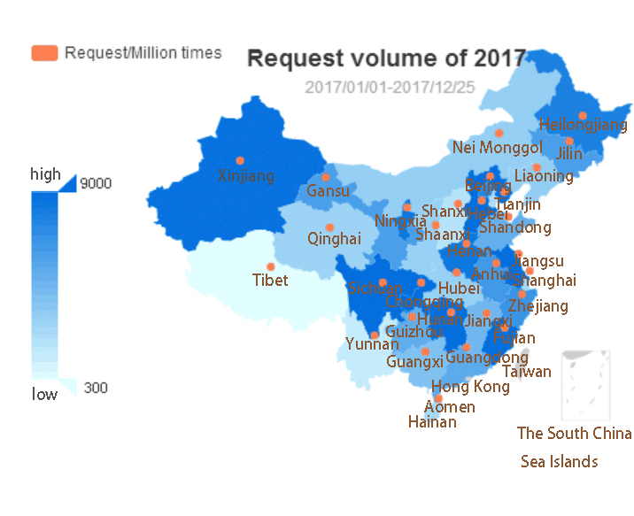
国开国开学习分析云平台
3.2 Online learning process analysis
The result provinces of the highest volume of requests are Sichuan, Chongqing, Jiangsu, Hunan, Hebei.
the diagram is completed by using Echarts.
Notes:
the platform also supports the data drilling function of different provinces, and clicks on different provinces to realize the request volume data display of different cities.

Slide 17
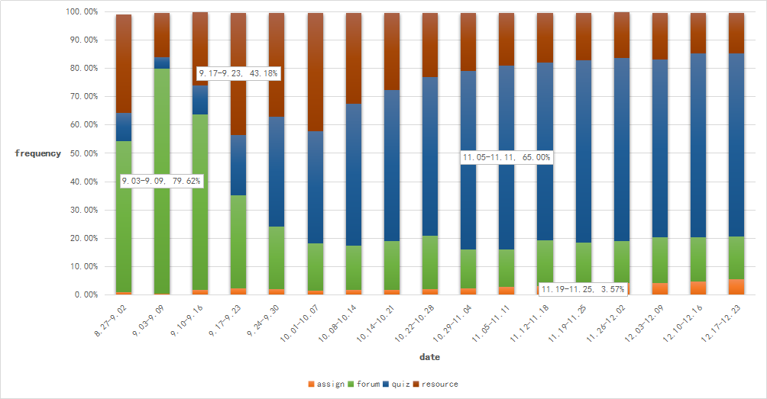
国开国开学习分析云平台
3.2 Online learning process analysis
forum, resource modules accounted for a large number.
it implements a frequency ratio map between different modules by using Excel.
Notes:
the platform also supports the data drilling function of different provinces, and clicks on different provinces to realize the request volume data display of different cities.

Slide 18
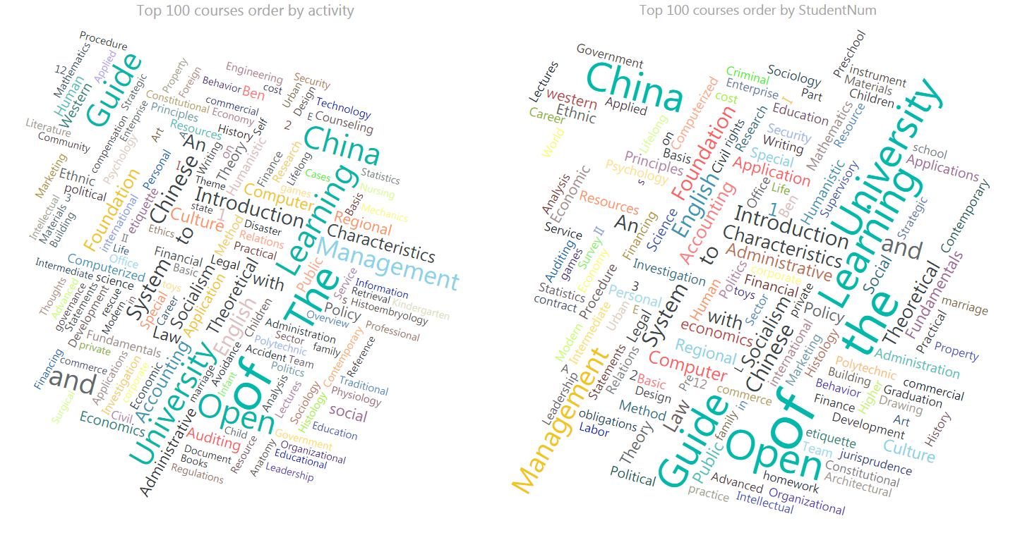
国开国开学习分析云平台
3.3 Analysis of Learning Result
The picture are drown by Power BI.
the courses of "Learning Guide of the Open University of China", "Introduction to the Theoretical System of Socialism with Chinese Characteristics et al.appear in top 100 courses of the largest number of students and 100 courses of the largest learning behavior.

Slide 19
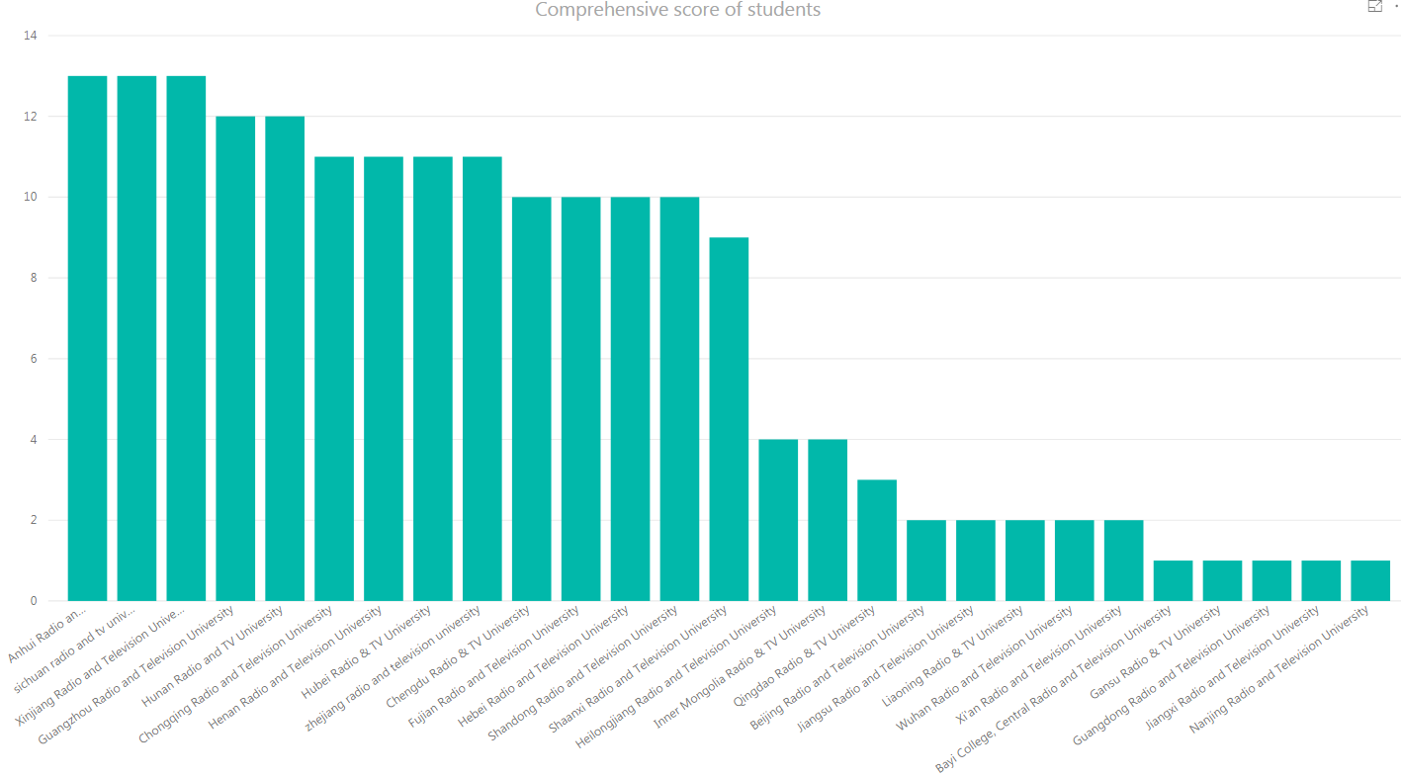
国开国开学习分析云平台
3.3 Analysis of Learning Result
The picture are drown by Power BI.
The branches of TOP 5 scores of students are Anhui, Sichuan, Xinjiang, Guangzhou, Hunan and Henan.

Slide 20
section
4
Conclusion

Slide 21
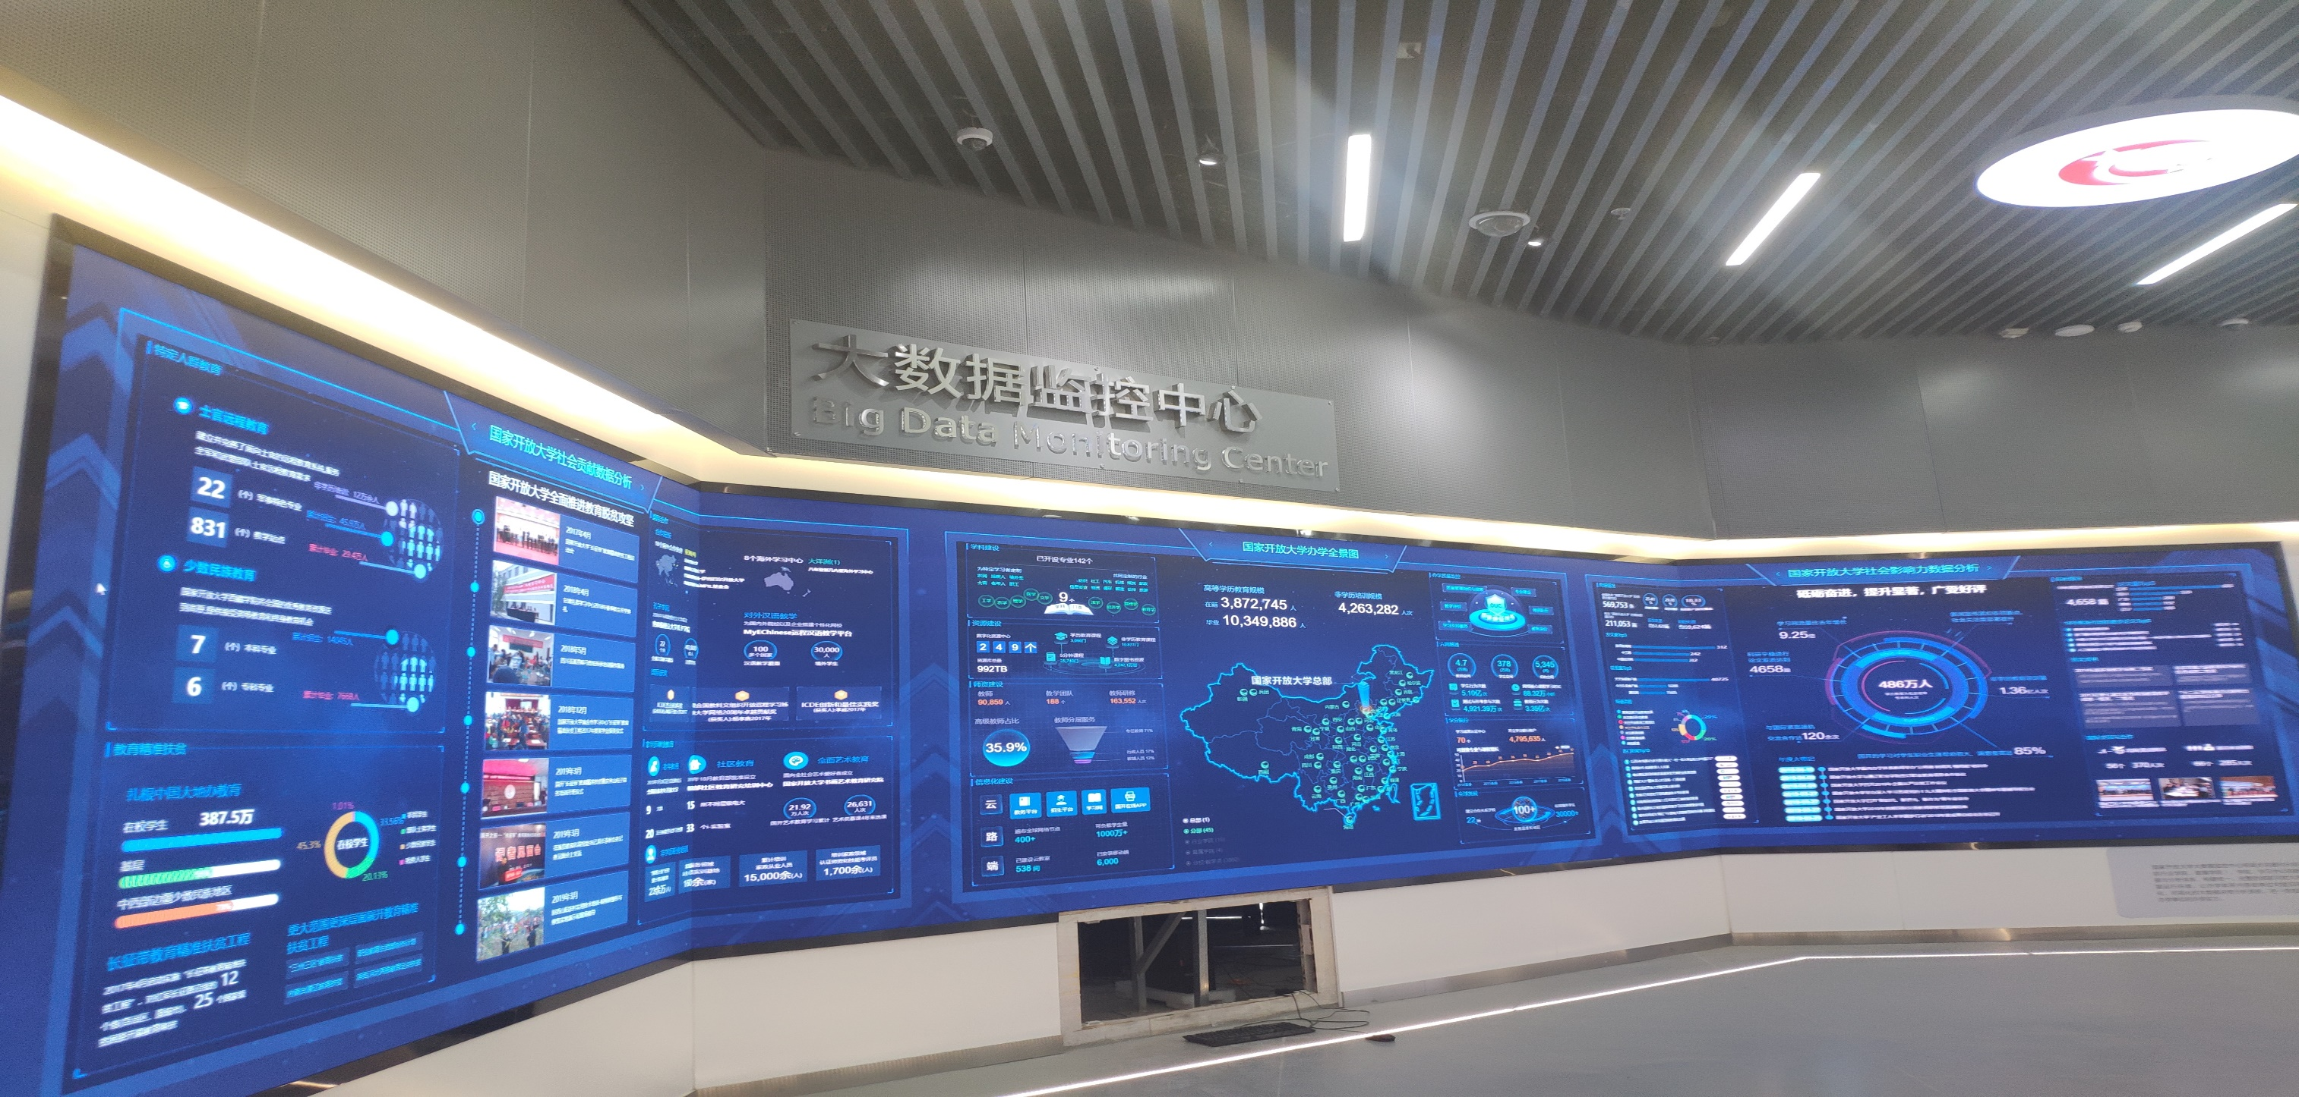
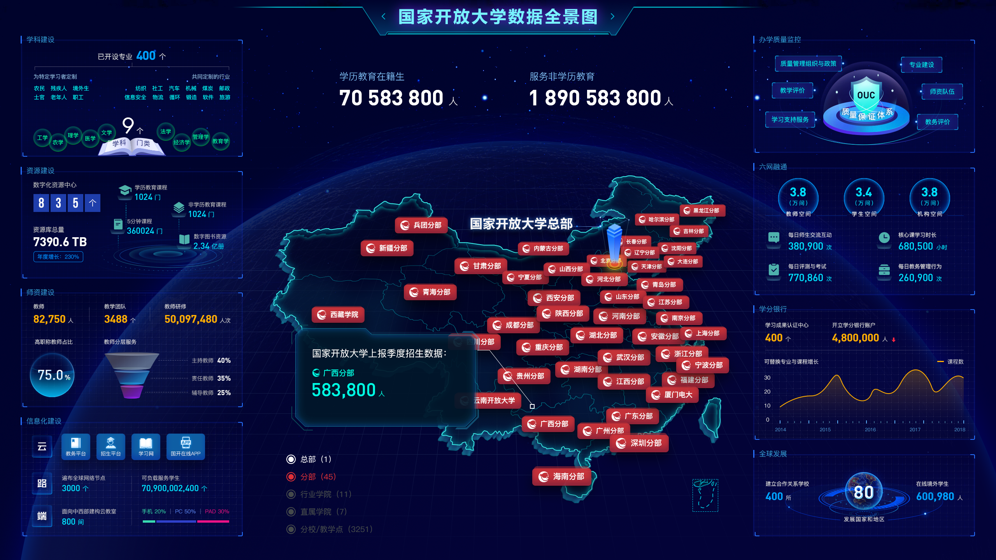
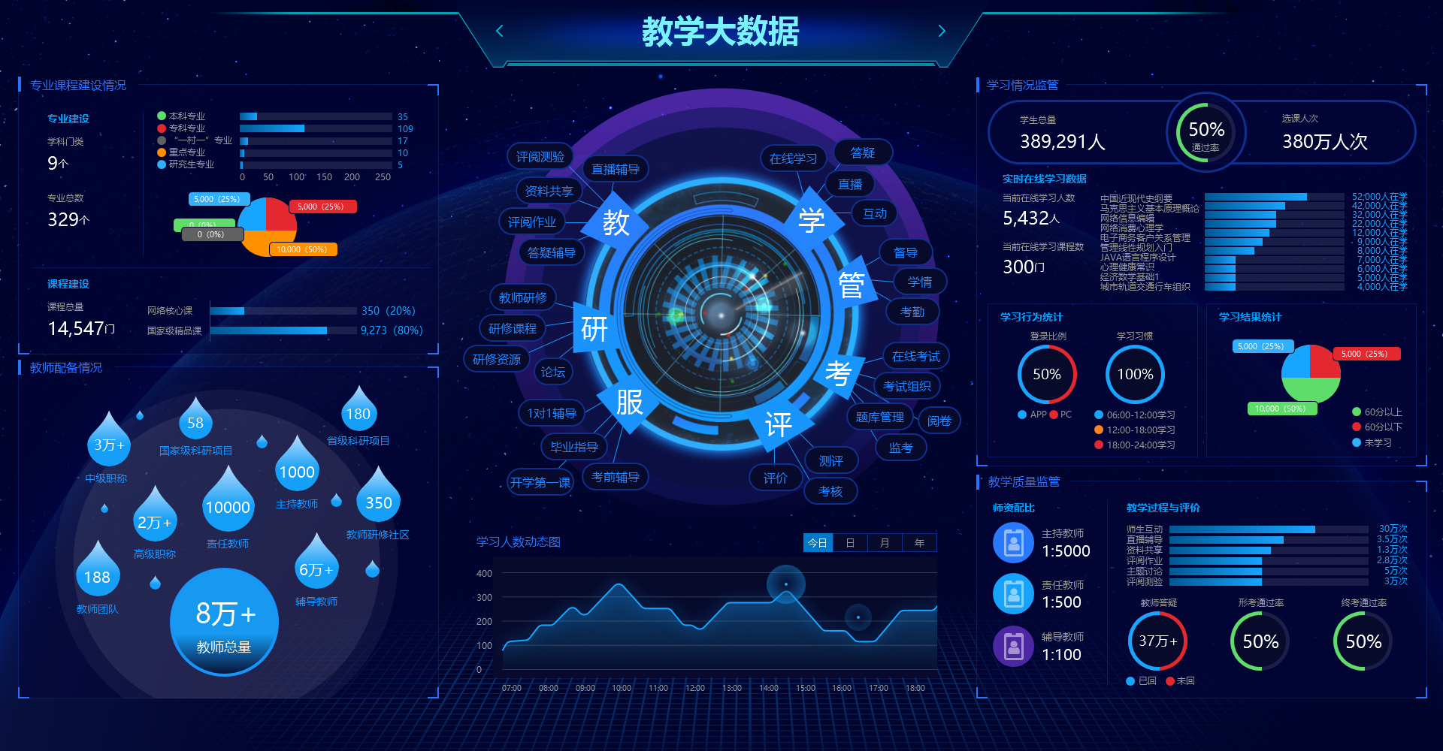
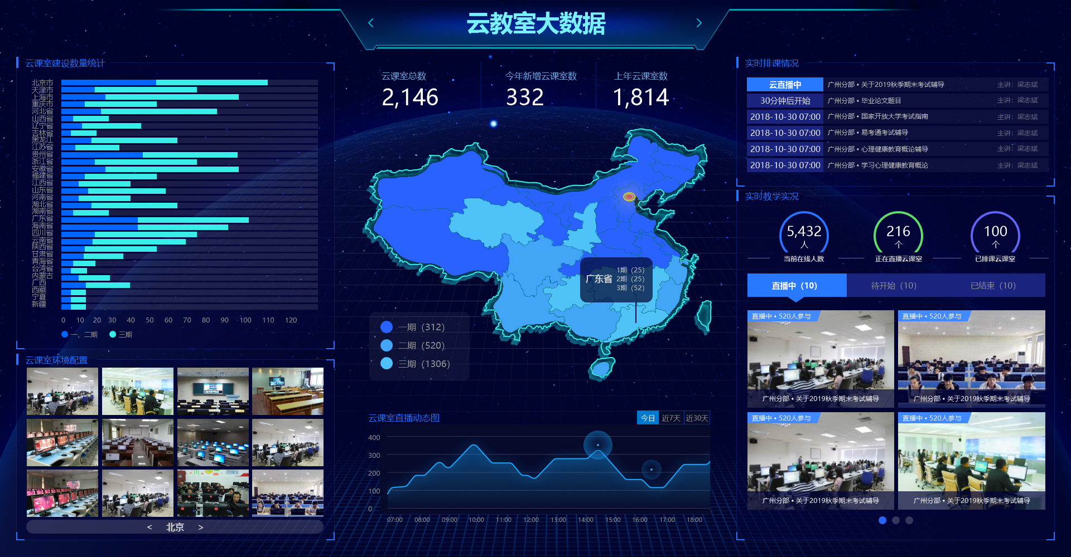
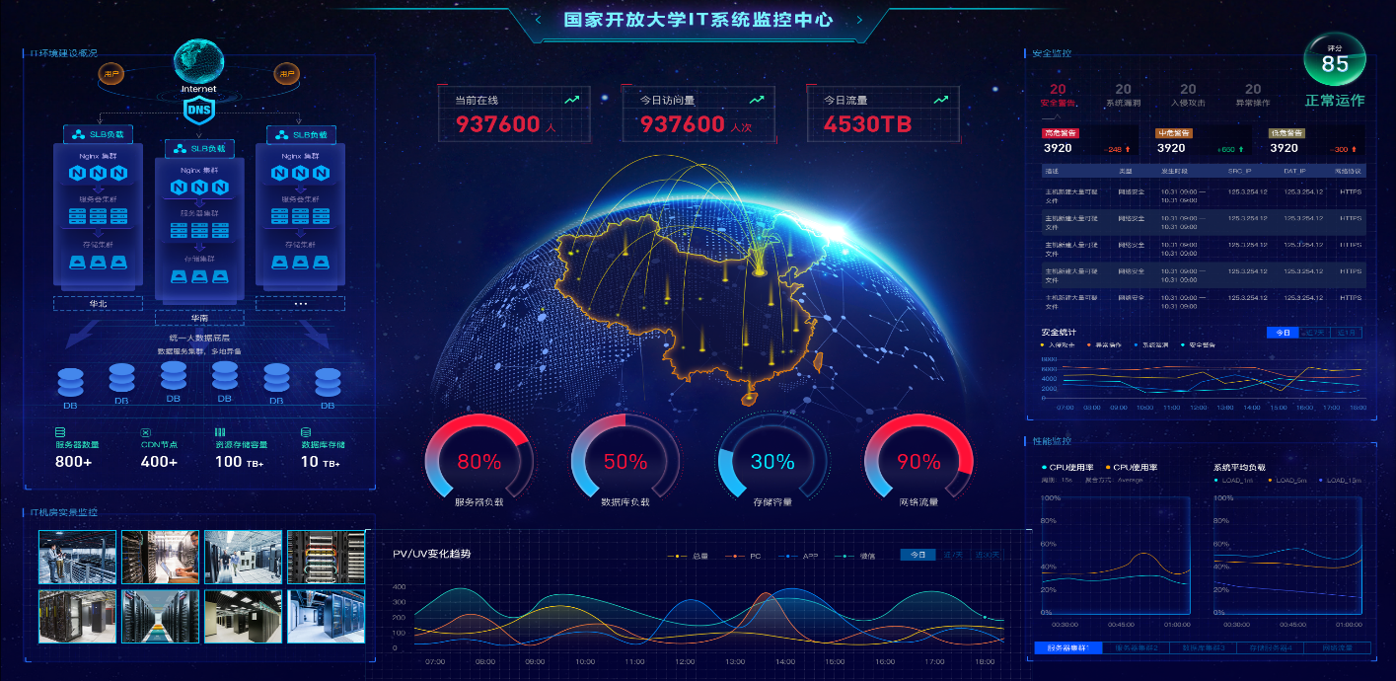
Application of LED screen
Based on the application provided by Huawei Cloud and the third-party BI manufacturers, the data monitoring center of the Open University of China draws all kinds of analysis results of enrollment, teaching, scientific research, public opinion and big data of cloud classrooms into charts in the form of BI reports and stages by making full use of data visualization technology.

Slide 22
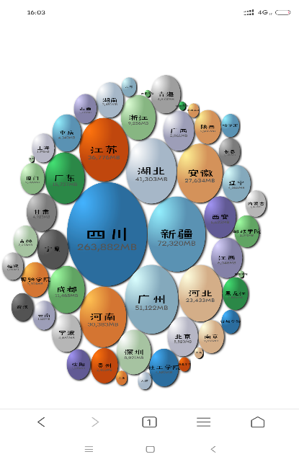
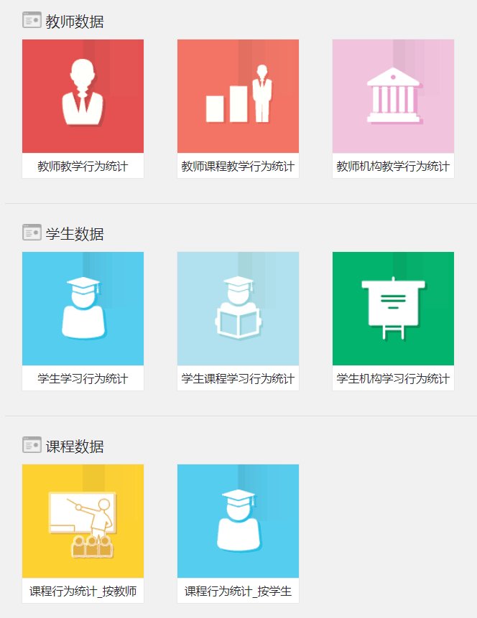
Application in PC and Mobile phone
PC
Mobile phone

Slide 23
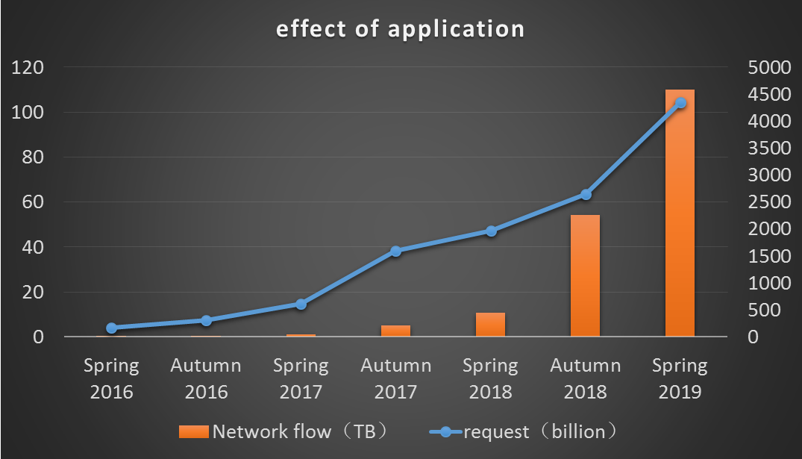
Effect of application
The network flow
request

Slide 24
4 Conclusion
The data monitoring center realizes the analysis and visualization of learners, whole learning, learning results to assist users in making decisions and enable users to more intuitively master the dynamics of teaching and learning.
Data visualization technology helps us complete the task of data analysis , greatly promotes students‘ enthusiasm for learning.

Slide 25
Thank you!
email
weiff@ouchn.edu.cn

