Slide 1
Diki, S.Si., M.Ed., Ph.D
Deddy Ahmad Suhardi MSi Ir. Argadatta Sigit M. Ed
Exam score pattern of distance learning students who do not attend tutorial

Slide 2
Exam score pattern of distance learning students who do not attend tutorial
Exam score pattern of distance learning students who do not attend tutorial
Exam score pattern of distance learning students who do not attend tutorial
Problems
Tutorial encourages students learning. Not the effect of tutorial toward GPA (Chandrawati, 2018)
Said & Syarif (2016) pointed out the importance of design of online learning. They did not include effect of tutorial. of online learning.
.

Slide 3
Exam score pattern of distance learning students who do not attend tutorial
Exam score pattern of distance learning students who do not attend tutorial
Literature review.
Tutorials have positive effect toward students in distance education. Koc (2016) showed that students taking online tutorial have better learning outcome. One significant factor of students’ learning outcome is submission in discussion forum during onine tutorial.
Olivier (2016) also found that students attened online tutorial had higher examination scores.
.

Slide 4
Exam score pattern of distance learning students who do not attend tutorial
Exam score pattern of distance learning students who do not attend tutorial
Exam score pattern of distance learning students who do not attend tutorial
Research question:
What is the pattern of relationship among final exam scores of each courses
in all semesters of students who do no attend any tutorial in biology and statistics department?
.

Slide 5
Exam score pattern of distance learning students who do not attend tutorial
Exam score pattern of distance learning students who do not attend tutorial
Exam score pattern of distance learning students who do not attend tutorial
Research method
Data are raw scores of final exam. There is quantitative variable, which is semester when the exam take place, and qualitative variable, which is department of the students. The research method is boxplot, multiple factor analysis with quantitative group of variables, and hierarchical cluster principal component.
Research method
Data are raw scores of final exam. There is quantitative variable, which is semester when the exam take place, and qualitative variable, which is department of the students. The research method is boxplot, multiple factor analysis with quantitative group of variables, and hierarchical cluster principal component.
.

Slide 6
Exam score pattern of distance learning students who do not attend tutorial
Exam score pattern of distance learning students who do not attend tutorial
Exam score pattern of distance learning students who do not attend tutorial
Participants of this study are students who do not attend any kinds of tutorial in biology department and statistics department of Faculty of Science and Technology, Universitas Terbuka.
There are 61 courses - 32 courses in biology and 29 courses in statistics.
The exam scores covers 13 semesters from 2012 through 2018.
.

Slide 7
Exam score pattern of distance learning students who do not attend tutorial
Exam score pattern of distance learning students who do not attend tutorial
Exam score pattern of distance learning students who do not attend tutorial
Department | 2012.2 | 2013.1 | 2013.2 | 2014.1 | 2014.2 | 2015.1 | 2015.2
Biology | 703 | 577 | 446 | 489 | 476 | 548 | 523
Statistics | 457 | 341 | 379 | 300 | 330 | 278 | 295
Grand Total | 1.160 | 918 | 825 | 789 | 806 | 826 | 818
 | 2016.1 | 2016.2 | 2017.1 | 2017.2 | 2018.1 | 2018.2 | Grand Total
Biology | 629 | 564 | 584 | 549 | 583 | 459 | 7.130
Statistics | 258 | 307 | 273 | 257 | 370 | 379 | 4.224
Grand Total | 887 | 871 | 857 | 806 | 953 | 838 | 11.354
.

Slide 8
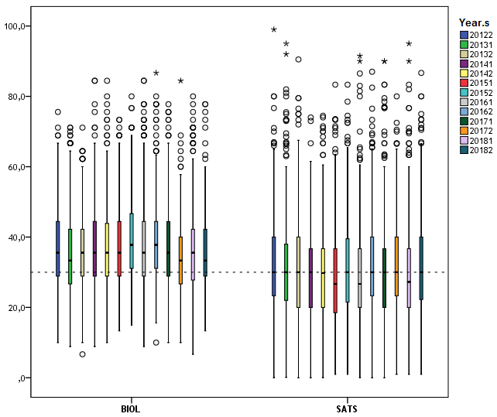
Exam score pattern of distance learning students who do not attend tutorial
Exam score pattern of distance learning students who do not attend tutorial
Exam score pattern of distance learning students who do not attend tutorial
.
Figure 1.
Boxplot of Final Exam Scores by Year.s and Study Program
(Notes: Horizontal reference line is a cut of point equal to 30 at the scores)

Slide 9
Exam score pattern of distance learning students who do not attend tutorial
Exam score pattern of distance learning students who do not attend tutorial
Exam score pattern of distance learning students who do not attend tutorial
Plot in Figure 1 is to measure distribution of final exam score in each semester of all courses in each department. Plot at Figure 1 shows distribution of exam score of all samples of all courses in each department. BIOL and SATS have 32 and 29 core courses, respectively.
Exam score of biology is 75% above cutting point of 30 to get minimum D. Meanwhile exam score of statistics are 50% above 30 point of minimum score. Exam score of biology students are slightly higher than statistics students.
Distribution of exam score between departments are heterogenous. Variation of scores in statistics are higher than biology.
.

Slide 10
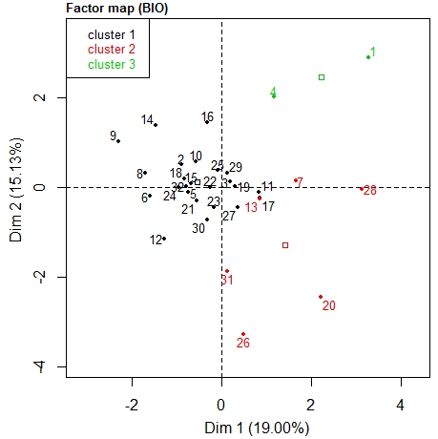
Exam score pattern of distance learning students who do not attend tutorial
Exam score pattern of distance learning students who do not attend tutorial
Exam score pattern of distance learning students who do not attend tutorial
Problems
.
Figure 2.
Courses cluster of Biology Studi Program projections on to first two dimensions of the number and final exam scores data

Slide 11
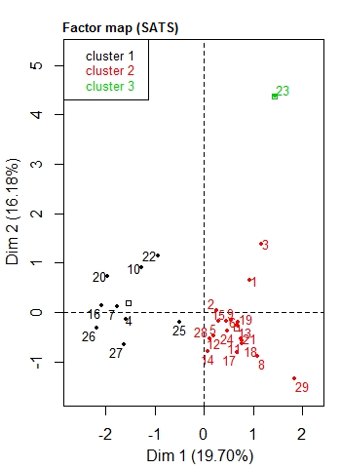
Exam score pattern of distance learning students who do not attend tutorial
Exam score pattern of distance learning students who do not attend tutorial
Exam score pattern of distance learning students who do not attend tutorial
Problems
.
Figure 3.
Courses cluster of Statistics Studi Program projections on to first two dimensions of the number and final exam scores data

Slide 12
Exam score pattern of distance learning students who do not attend tutorial
Exam score pattern of distance learning students who do not attend tutorial
Exam score pattern of distance learning students who do not attend tutorial
Discussion
Lower number:
Only students of its department
Courses at the end of a program
Retaking similar courses
Lower score:
Need tutorial

Slide 13
Exam score pattern of distance learning students who do not attend tutorial
Exam score pattern of distance learning students who do not attend tutorial
Exam score pattern of distance learning students who do not attend tutorial
Conclusion
Exam score of biology is 75% above cutting point of 30 to get minimum D. Meanwhile exam score of statistics are 50% above 30 point of minimum score. Exam score of biology students are slightly higher than statistics students.
Distribution of exam score between departments are heterogenous. Variation of scores in statistics are higher than biology
Conclusion
Exam score of biology students are slightly higher than statistics students.
Students need tutorial
between departments are heterogenous. Variation of scores in statistics are higher than biology
.

Slide 14
THANK
YOU

