Slide 1
Achievement and Limitation of Online Library Instruction in Distance University Using Google Web Applications
Library of Korea National Open University
coolarmani@knou.ac.kr

Slide 2
Characteristics of Students at K.N.O.U. and Limitation of library instruction.
Self-Directed Learning, Perform Online Learning
Less likely to use physical library, use only limited amount of library data.
Library provides Face-to-Face Library Instructions.
A small number of people are participating.

Slide 3
Google Web Applications for Online library instruction
1. Google site
Allows to Create a Webpage
Platform for users who participate in online library instructions

Slide 4
Google Web Applications for Online library instruction
2. Youtube
upload and share video clips
Expanded to personal broadcasting through live streaming
Participating in library instruction through Youtube live streaming

Slide 5
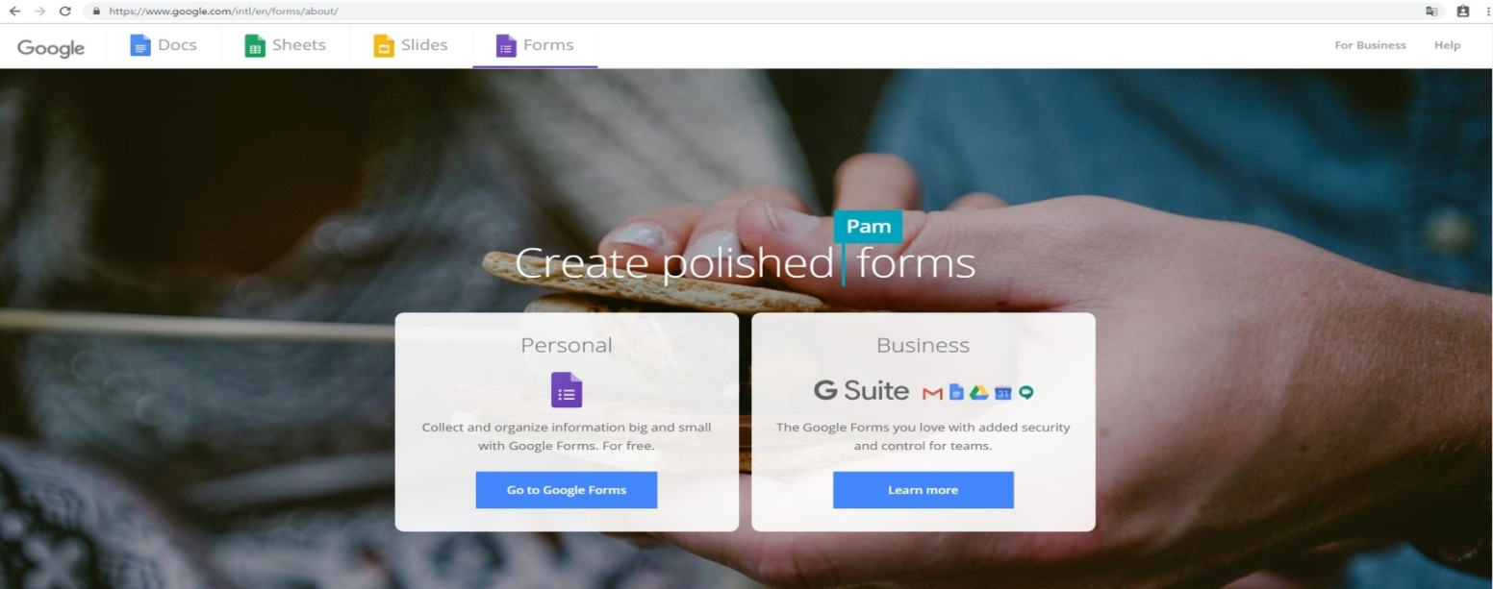
Google Web Applications for Online library instruction
3. Google Form
Application to manage user surveys and utilizes Google Docs
Provide a feature of questions and answers during the lecture
Channel to communicate with lecturers during library instruction

Slide 6
Processing of Online library instruction
1. Preparing to use Google Web Applications
Creating Google Account: For library’s unique settings and information
http://accounts.google.com
Creating web page using Google Site: For access point and platform
of online library instruction http://sites.google.com

Slide 7
Processing of Online library instruction
1. Preparing to use Google Web Applications
Creating YouTube channel : To provide and share live streaming for
online library instruction, Enables the creation of unique channel
for library. It makes us provide unique contents for library.
http://accounts.google.com
Creating Google Form : For Realtime Feedback.
To answer real-time question with users during the instruction.
http://www.google.com/intl/en-GB/forms/about/

Slide 8
Processing of Online library instruction
2. Creating Web Page for Online library instruction
https://sites.google.com/a/knou.ac.kr/lib/

Slide 9
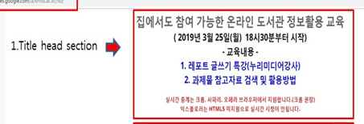
Processing of Online library instruction
2. Creating Web Page for Online library instruction
Title Head Section: Guides schedule and significant announcements

Slide 10
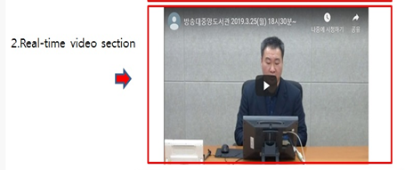
Processing of Online library instruction
2. Creating Web Page for Online library instruction
Live Streaming Section: Streams library instructions video to users

Slide 11
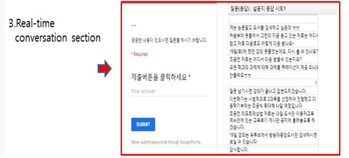
Processing of Online library instruction
2. Creating Web Page for Online library instruction
Real-time Conversation Section: Allows users to ask and answer questions in real-time during the instruction

Slide 12
Results of providing online library instruction
1) Currents status of conducting online library instruction
Classification | Number of time | Participants in Online library user’s education | Average number of participants Per session | Year-on-year growth rate of average participants
2017 | 4 | 2,727 | 682
2018 | 4 | 2,949 | 737 | 8.1%
1st Semester 2019 | 3 | 6,437 | 1,609 | 118.3%
2) Currents status of conducting face-to-face library instruction
Classification | Number of time | Participants in Online library user’s education | Average number of participants Per session | Year-on-year growth rate of average participants
2017 | 62 | 1,277 | 44
2018 | 47 | 863 | 35 | △20%
1st Semester 2019 | 21 | 234 | 11 | △68%

Slide 13
Achievement and limitation of online library instruction
Sharp Increase in the number of participants each year
Average number of participants per session soaring 118.3% on year
(1st Semester 2019)
WHY??
Combination of changes in the use of ICT and E-environment.
especially, video using trends are becoming more prevalent
Demand for distance university’s users to conduct online learning.
It’s time to improve quality rather than increasing quantity

Slide 14
Achievement and limitation of online library instruction
1.Need to create various instructions for each participant level
Two-way communication is essential value for effective instruction
Various level(Information literacy level, Information devices skillfulness) of participants essential value for effective instruction
Less than 10 times per session on average (questions)
Various online library instructions by level of participants
Active discussions and effective instruction

Slide 15
Achievement and limitation of online library instruction
2. Shortening the time of online library instruction
Easy to be loss of concentration (Online <-> Face-to-Face)
Mostly about 10 minutes of instruction time (YouTube video clips)
90 minutes of current instruction time
3. Preparing an online Information literacy program
Change access platform (Web pages → Video platform)
Characteristics of learner at Distance university
Expanded to various information literacy programs

Slide 16
Thank you

