Slide 1
Educational Technology
&
Technology in Education
Azhar Zia-ur-Rehman
CISA CISM CRISC ITIL MS BE
Lead Cybersecurity Manager
ISO27k Certified Lead Auditor
ISO20000 Lead Auditor
ISO22301 Lead Auditor
P.O.Box 47859. Abu Dhabi, UAE
971 50 6139436
92 316 626 9792
azharzr@rehmaniyah.com

Slide 2
Parallel Session 1.2 - Theme: Educational Technology and Technology in Education - Venue: Emerald Hall-A Session Chair: Azhar Zia Ur Rehman - Moderator: Qurat ul ain
Sr. No. | Presentation Title | Presented by
1 | Design, Usage and Impact of Virtual University Mobile LMS Application on Students Learning of Virtual University of Pakistan | Masroor Ahmed and Dr. Shahid Minhas Minhas
2 | E-Learning Vlog Model Development: Enhancing Learning Motivation and Cognitive Ability (A Case Study of Students of Budgeting) | Andi Sylvana and Murtiadi Awaluddin
3 | Design and Development of Virtual Practice Learning Contents with Learning Cloud | Kwang Sik Chung, Sang Im Jung, Yeon Sin Kim, Chung Hun Lee and Younghee Woo
4 | Golden: Geospatial Model for Distance Education | Kamran Mir
5 | Challenges in Teaching Probability Distributions through Open Distance Learning: Experiences and Insights | Saleha Naghmi Habibullah
6 | Technological Exploration and Theoretical Innovation in the Reform and Development of the Open University: VR Resource, Cloud Classroom, Flat Management | Huai-Qiang Zhang
7 | Improving Self-Regulation in Online Distance Learning through Self-Efficacy and Creativity (A Study Case at UPBJJ UT Makassar) | Subirman Musa, Diki, Andi Sylvana and Murtiadi Awaluddin
8 | Internet of Things (IoT) Practices in Primary and Secondary Schools in Selected Provinces in Zambia | Daniel Mpolomoka and Kamran Mir

Slide 3
Educational Technology
Technology in Education
Parallel Session 1.2 - Theme: Educational Technology and Technology in Education - Venue: Emerald Hall-A Session Chair: Azhar Zia Ur Rehman - Moderator: Qurat ul ain
Sr. No. | Presentation Title | Presented by
1 | Design, Usage and Impact of Virtual University Mobile LMS Application on Students Learning of Virtual University of Pakistan | Masroor Ahmed and Dr. Shahid Minhas Minhas
2 | E-Learning Vlog Model Development: Enhancing Learning Motivation and Cognitive Ability (A Case Study of Students of Budgeting) | Andi Sylvana and Murtiadi Awaluddin
3 | Design and Development of Virtual Practice Learning Contents with Learning Cloud | Kwang Sik Chung, Sang Im Jung, Yeon Sin Kim, Chung Hun Lee and Younghee Woo
4 | Golden: Geospatial Model for Distance Education | Kamran Mir
5 | Challenges in Teaching Probability Distributions through Open Distance Learning: Experiences and Insights | Saleha Naghmi Habibullah
6 | Technological Exploration and Theoretical Innovation in the Reform and Development of the Open University: VR Resource, Cloud Classroom, Flat Management | Huai-Qiang Zhang
7 | Improving Self-Regulation in Online Distance Learning through Self-Efficacy and Creativity (A Study Case at UPBJJ UT Makassar) | Subirman Musa, Diki, Andi Sylvana and Murtiadi Awaluddin
8 | Internet of Things (IoT) Practices in Primary and Secondary Schools in Selected Provinces in Zambia | Daniel Mpolomoka and Kamran Mir

Slide 4
Distance & Virtual Learning
owes its existence to TECHNOLOGY

Slide 5
TECHNOLOGY GOVERNANCE
is vital for
Distance & Virtual Learning

Slide 6
TECHNOLOGY GOVERNANCE
Processes

Slide 7
TECHNOLOGY GOVERNANCE Processes
1. Technology Watch
5. Technology Adoption
2. Industry Watch
6. Technology Safeguarding
3. Industrial Espionage
7. Technology Retirement
4. Innovation
8. Technology Management

Slide 8
Implementing & Ensuring
TECHNOLOGY GOVERNANCE

Slide 9
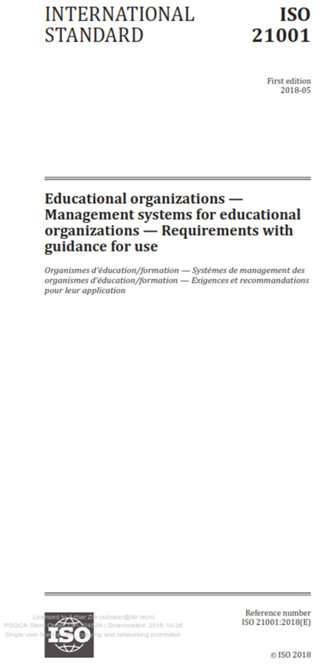
ISO 21001:2018

Slide 10
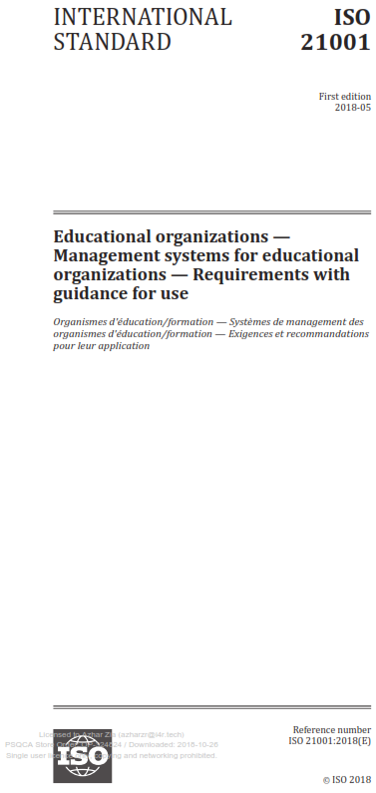
Leadership
Planning
Support
Operation
Performance Evaluation
Improvement

Slide 11
To succeed,
distance and virtual learning institutions
must implement
TECHNOLOGY GOVERNANCE
and ISO 21001:2018

Slide 12
Thanks!
Azhar Zia-ur-Rehman
CISA CISM CRISC ITIL MS BE
Lead Cybersecurity Manager
ISO27k Certified Lead Auditor
ISO20000 Lead Auditor
ISO22301 Lead Auditor
P.O.Box 47859. Abu Dhabi, UAE
971 50 6139436
92 316 626 9792
azharzr@rehmaniyah.com

