Slide 1
Role of Open & Distance Learning
in
Defining the Future of Work
in the
Fourth Industrial Revolution
Azhar Zia-ur-Rehman
CISA CISM CRISC ITIL MS BE
Lead Cybersecurity Manager
ISO27k Certified Lead Auditor
ISO20000 Lead Auditor
ISO22301 Lead Auditor
P.O.Box 47859. Abu Dhabi, UAE
971 50 6139436
92 316 626 9792
azharzr@rehmaniyah.com

Slide 2
Major factors effecting the Future of Work?
Technological Change
Learning Evolution
Talent Mobility
These factors may change fast or gradually
giving rise to 8 distinct scenarios
Azhar Zia-ur-Rehman
AAOU2019

Slide 3
Scenario 1/8
Workforce Autarky/Independence
Technological Change
Slow Change
Role of Open & Distance Learning
Keep syllabi tuned to gradual technology change
Ensure that the stable market demands are met
Plan series of courses for the same audience
Learning Evolution
Slow Learning
Talent Mobility
Low mobility
Azhar Zia-ur-Rehman
AAOU2019

Slide 4
Scenario 2/8
Mass Movement
Technological Change
Slow Change
Role of Open & Distance Learning
Keep syllabi tuned to gradual technology change
Ensure that the demands of the local and the target markets are met
Plan courses for the changing audience
Learning Evolution
Slow Learning
Talent Mobility
High mobility
Azhar Zia-ur-Rehman
AAOU2019

Slide 5
Scenario 3/8
Robot Replacement
Technological Change
Fast Change
Role of Open & Distance Learning
Revise syllabi very frequently
Plan series of courses for alumni
Target new courses at the same market
Learning Evolution
Slow Learning
Talent Mobility
Low mobility
Azhar Zia-ur-Rehman
AAOU2019

Slide 6
Scenario 4/8
Polarized World
Technological Change
Fast Change
Role of Open & Distance Learning
Revise syllabi very frequently
Plan of courses for the changing market
Learning Evolution
Slow Learning
Talent Mobility
High mobility
Azhar Zia-ur-Rehman
AAOU2019

Slide 7
Scenario 5/8
Empowered Entrepreneurs
Technological Change
Slow Change
Role of Open & Distance Learning
Target new needs of the same market
Learning Evolution
Fast Learning
Talent Mobility
Low mobility
Azhar Zia-ur-Rehman
AAOU2019

Slide 8
Scenario 6/8
Skilled Flows
Technological Change
Slow Change
Role of Open & Distance Learning
Revise syllabi to suit the changing market
Learning Evolution
Fast Learning
Talent Mobility
High mobility
Azhar Zia-ur-Rehman
AAOU2019

Slide 9
Scenario 7/8
Productive Locals
Technological Change
Fast Change
Role of Open & Distance Learning
Revise syllabi very frequently
Add new products for the same market
Learning Evolution
Fast Learning
Talent Mobility
Low mobility
Azhar Zia-ur-Rehman
AAOU2019

Slide 10
Scenario 8/8
Agile Adaptors
Technological Change
Fast Change
Role of Open & Distance Learning
Track the market needs
Align with the industry
Keep up with the technology
Integrate with the partners
Revise syllabi very frequently
Learning Evolution
Fast Learning
Talent Mobility
High mobility
Azhar Zia-ur-Rehman
AAOU2019

Slide 11
Demands on Open & Distance Learning
1. Good governance
2. Quality
3. Agility
4. Vertical integration
5. Horizontal integration
Azhar Zia-ur-Rehman
AAOU2019

Slide 12
How to achieve this?
1. Good governance
Adopt and implement standards
2. Quality
3. Agility
4. Vertical integration
5. Horizontal integration
Azhar Zia-ur-Rehman
AAOU2019

Slide 13
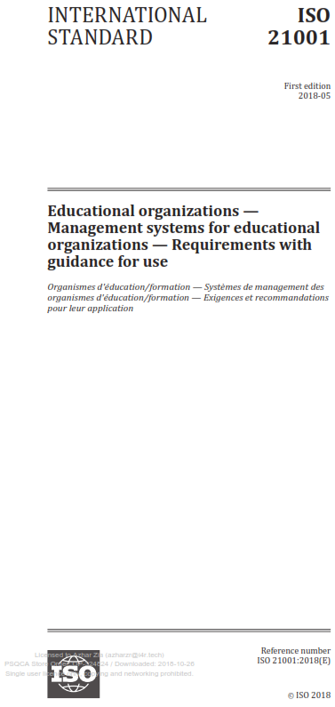
Which Standard?
Adopt and implement standards
Azhar Zia-ur-Rehman
AAOU2019

Slide 14
ISO 21001:2018
Leadership
Planning
Support
Operation
Performance Evaluation
Improvement
Azhar Zia-ur-Rehman
AAOU2019

Slide 15
Implementing ISO 21001:2018
Utilize the faculty under the leadership of an expert
Set the tone at the at the top – Leadership/Governance
Document processes smartly
Implement enterprise risk management
Implement data governance
Transform to a quality culture
Azhar Zia-ur-Rehman
AAOU2019

Slide 16
The future is
Open & Distance Learning
BUT …
Azhar Zia-ur-Rehman
AAOU2019

Slide 17
Thanks!
Azhar Zia-ur-Rehman
CISA CISM CRISC ITIL MS BE
Lead Cybersecurity Manager
ISO27k Certified Lead Auditor
ISO20000 Lead Auditor
ISO22301 Lead Auditor
P.O.Box 47859. Abu Dhabi, UAE
971 50 6139436
92 316 626 9792
azharzr@rehmaniyah.com

