Slide 1
Use of Self-Regulated Learning Strategies among High and Low Achiever Undergraduate Students in Open and Distance Learning

Slide 2
Amina Latif
Instructor Education
Virtual University of Pakistan
Dr. Munawar Sultana Mirza
Advisor Acadamics
Virtual University of Pakistan

Slide 3
What is self regulated learning?
why is it important in online distant environment?

Slide 4
Pintrich (2000)
“An active and constructivist process whereby learners attempt to monitor, regulate, and control their cognition, motivation and behaviors after setting goals for their learning, are guided and restricted by their own goals and the learning environment they are in" (p. 453).

Slide 5
Background/Introduction
Self Regulated learning (SRL) predictor/
correlate of learning achievement.
SRL strongly related with other student relate variables e.g. motivation, exhaustion etc. which may affect their learning achievement
SRL is more desired trait from students in online distant learning (ODL) settings as compared to conventional settings.

Slide 6
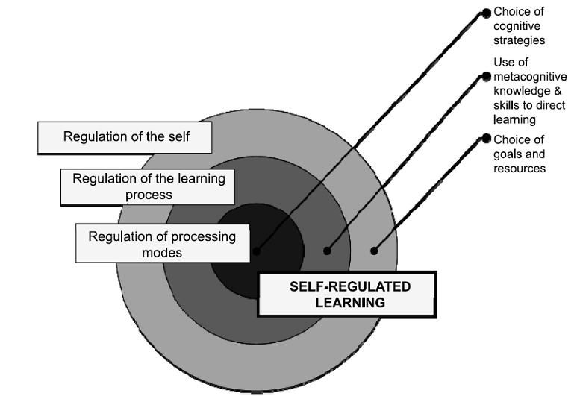
BIG CONCEPT
Bring the attention of your audience over a key concept using icons or illustrations
Source: Boekaerts 1999, p. 449

Slide 7
Research Objectives
To find out the use of Self-regulated learning strategies among ODL students.
To compare the level of self-regulation among high and low achieving students.
Cross discipline comparison of students for the use of self-regulated learning strategies.
To compare the use of self-regulated learning strategies among male and female students

Slide 8
Self Regulation
Goal Setting
Help Seeking
Maganging Physical environment
Effort Regulation
Self Study Strategies
Achievement Lavel
High Achievers
Low Achievers

Slide 9
Methods
Quantitative descriptive study
Survey research design
Questionnaire

Slide 10
Population and Sample of the Study
Population BS Hons. Students
15033
Target population
2468
Sample
303

Slide 11
Population and Sample Distribution
 | A | B | C
Yellow | 10 | 20 | 7
Blue | 30 | 15 | 10
Orange | 5 | 24 | 16
Sr. No. | Study Program | Total Enrollment | Target Population | Sample
 | Psychology | 736 | 198*2=396 | 38+18=56
2. | Information Technology | 1779 | 480*2=960 | 37+27=64
3. | B.Ed (Hons) Elementary | 118 | 35*2=70 | 40+29=69
4. | Business Administration | 889 | 240*2=480 | 52+8=60
5. | Mathematics | 1041 | 281*2=562 | 27+27=54
 | Total | 4560 | 2468 | 303

Slide 12
Kocdar, Karadeniz, Bozkurt & Buyuk (2018). Cronbach’s Alpha reliability .950
Goal Setting
Help Seeking
Self Study Strategies
Managing Physical Environment
Effort Regulation

Slide 13
Comparison of high and low achieving students on sub-factors of self-regulation
Factor | Ach. Level | N | Mean | SD | Sig. | Theoretical Range
Goal Setting | Low | 140 | 19 | 4.216 | .111 | 5-25
 | High | 163 | 19 | 3.474
Help Seeking | Low | 140 | 25 | 8.019 | .000 | 9-45
 | High | 163 | 27 | 8.867
Self-Study | Low | 140 | 29 | 7.150 | .119 | 8-40
 | High | 163 | 31 | 5.344
Physical Environment | Low | 140 | 23 | 5.097 | .209 | 6-30
 | High | 163 | 25 | 3.964
Effort Regulation | Low | 140 | 7 | 1.873 | .659 | 2-10
 | High | 163 | 8 | 1.670
Total Self- Regulation | Low | 140 | 103 | 21.132 | .002 | 30-150
 | High | 163 | 109 | 14.847

Slide 14
Comparison of high and low achieving students for SRL within each discipline
Department | Ach. Level | N | Mean | SD | Sig. | Mean Difference
Information Technology | Low | 27 | 98 | 22.770 | .057 | -9.057
 | High | 37 | 107 | 14.552
Business Administration | Low | 8 | 88 | 27.802 | .002 | -20.451
 | High | 52 | 108 | 13.916
Psychology | Low | 38 | 110 | 17.578 | .830 | -1.105
 | High | 18 | 111 | 18.474
Mathematics | Low | 27 | 102 | 18.265 | .206 | -5.962
 | High | 27 | 108 | 15.885
Education | Low | 40 | 104 | 21.885 | .024 | -10.514
 | High | 29 | 115 | 12.934

Slide 15
By Gender comparison
 | Gender | N | Mean | SD | Mean Difference | Sig.
Self-Regulation Score | Female | 153 | 103.464 | 19.049 | 6.335 | .002
 | Male | 150 | 109.800 | 16.885

Slide 16
Cross Discipline comparison of Students for the Level of Self-Regulation (ANOVA)
Levene’s Test of Homogeneity of Variances .980
No significant difference in level of self-regulation of students over the five study disciples e.g. Arts, Computer Science and Information Technology, Science and Technology, Education and Management Science.

Slide 17
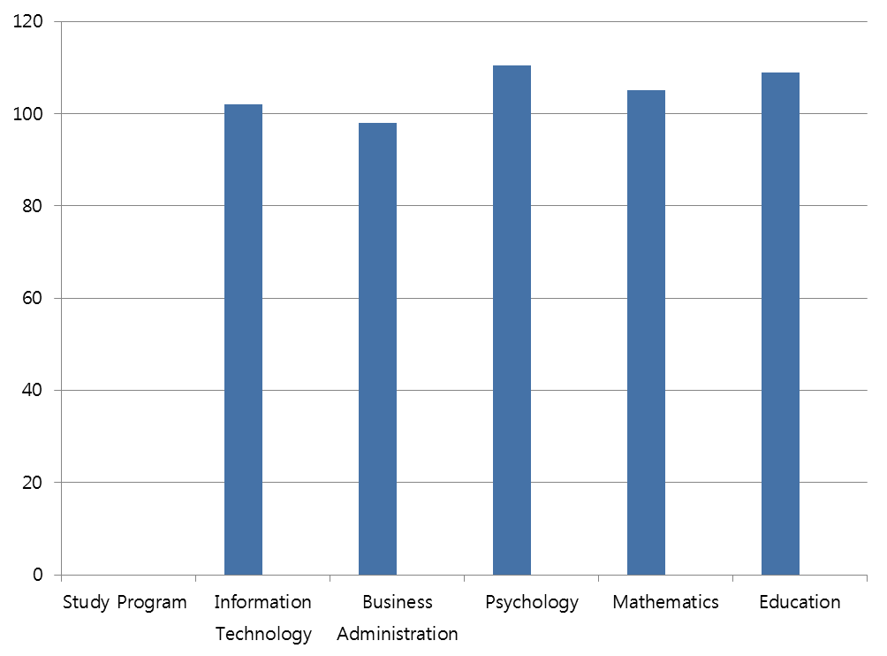
SRL Mean Score of Different Study Programs

Slide 18
Recommendations
Self-regulated learning strategies shall be promoted among ODL student with a special focus to build help seeking behavior among students regarding their study needs.

Slide 19
Thanks!
Any questions?
You can find me at:
amina.latif@vu.edu.pk

